Slide 1
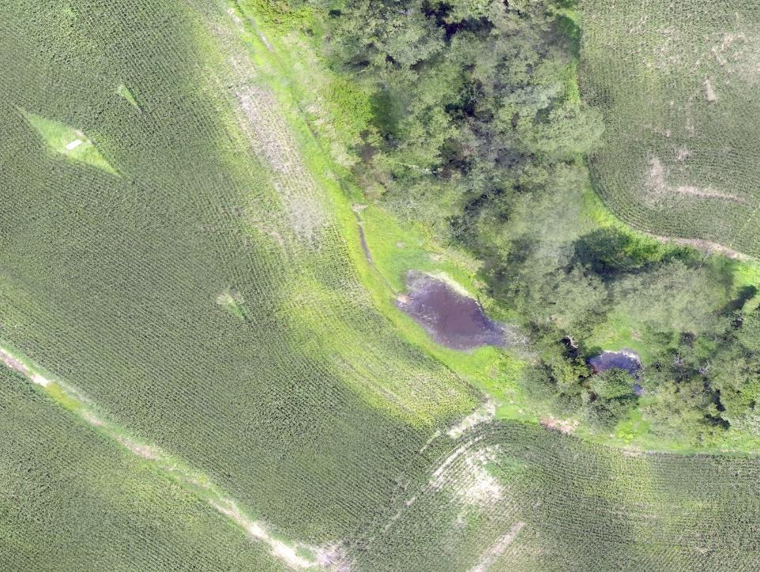
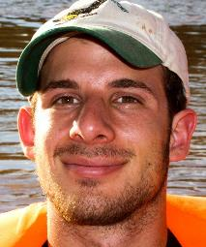

Wildlife habitat: dangerous or protective for our food supply?
Research by Daniel S. Karp
University of California - Davis
Presented by Jon Fisher
Center for Sustainability Science (TNC)
Photo from Jon Fisher
Notes:
More about Jon at http://www.nature.org/science-in-action/our-scientists/jon-fisher.xml
More about Danny at http://karp.ucdavis.edu/people/daniel-karp/
Photos all courtesy of Danny Karp

Slide 2
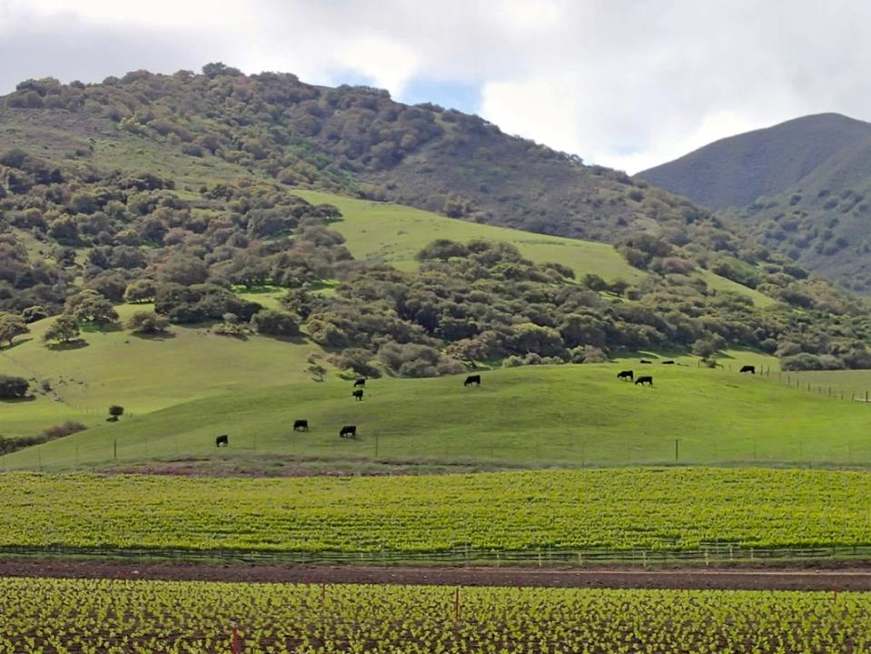
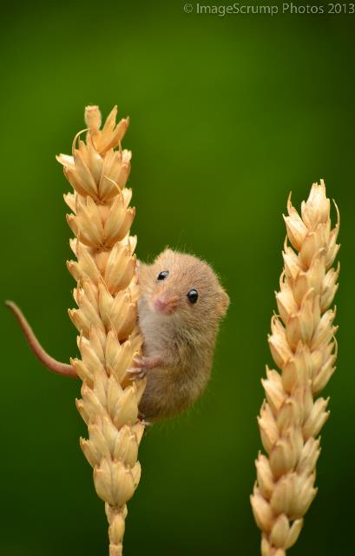
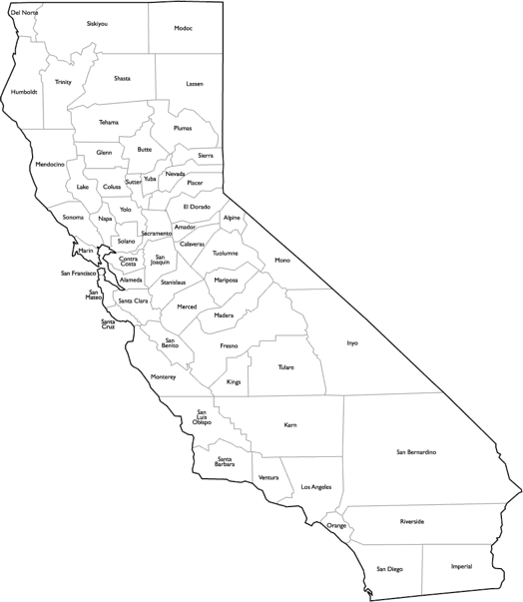
2006 – Major E. coli outbreak from spinach
California’s
Central Coast
Photo from Flickr user westcountryboy75
Photo from Daniel Karp
Notes:
E coli outbreak – 3 dead, 200 sick (diarrhea to kidney failure) across 25 states
Traced to CA central coast (presumably poop containing e coli in fields)
Greens companies blamed wildlife and decided to try to reduce contamination by getting them out of fields
Background photo from Danny Karp, mouse photo from https://www.flickr.com/photos/westcountryboy75/9125950933/

Slide 3
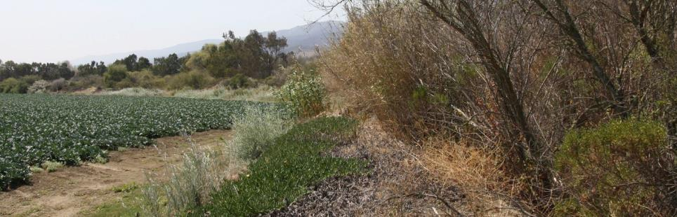
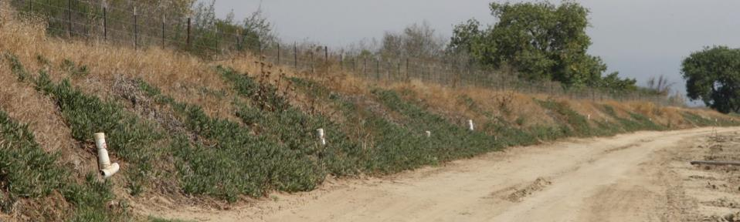
Response: farmers reduce wildlife habitat
~40% produce growers in CA cleared vegetation
Rodent
traps
Wildlife
fences
Vegetation
removal
Baur, P., L. Driscoll, S. Gennet, & D.S. Karp (2016) Inconsistent food safety pressures complicate environmental conservation for California produce growers. California Agriculture. 70: 142-151.
Photos from Daniel Karp
Notes:
Farmers were encouraged / required to clear habitat, use rodent traps, and add fences
This was (and is) widespread, 40% of growers clearing veg in one survey
USDA was considering codifying this into law
Photos from Danny Karp

Slide 4
Does clearing habitat make us safer?
Land Cover Change
Enterohemorrhagic E. coli in leafy greens
  237,306 tests at 74 farms (2007-2013)
Indicator E. coli in water (e.g., wells & waterways)
  6,887 tests at 484 farms (2007- 2010)
Δ E. coli
Less Habitat ← More Habitat
Notes:
This action was taken without evidence
Danny used data on LC & E coli to see if it was working or not
Strong evidence that clearing habitat didn’t reduce e coli, and some evidence that it may even have increased it
It is likely that natural habitat was filtering out some of the contamination

Slide 5
What else could it be?
Effect of Land Use on E. Coli
In Leafy Greens
Photo from Daniel Karp
Notes:
grazeable land (cows, potentially also feral pigs) ARE associated with increasing e coli contamination
Again, habitat appears to be reducing contamination
Background photo from Flickr user CUESA under creative commons: https://www.flickr.com/photos/cuesa/4460206741/

Slide 6
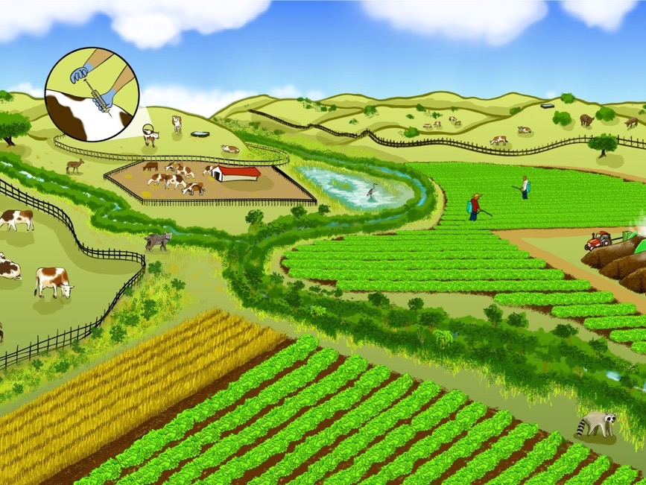
So what do we do now?
Fencing streams
Buffering with appropriate crops
Maintaining vegetation
© Mattias Lanas and Joseph Burg
Notes:
Many things we can do to reduce risk, here are just a few to start

Slide 7
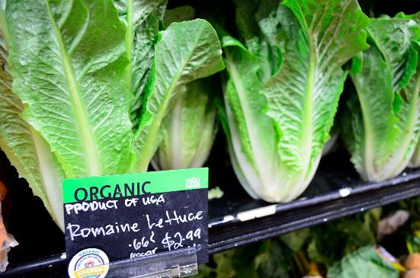
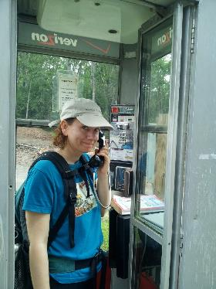
Call to action: visit http://salad.sciencejon.com
Photo from Flickr user opengridscheduler
Photo from Jon Fisher
References:
Karp DS, Gennet S, Kilonzo C, Partyka M, Chaumont N, Atwill ER, et al. Comanaging fresh produce for nature conservation and food safety. Proc Natl Acad Sci. 2015; doi:10.1073/pnas.1508435112
Karp DS, Moses R, Gennet S, Jones MS, Joseph S, M’Gonigle LK, et al. Agricultural practices for food safety threaten pest control services for fresh produce. Manning P, editor. J Appl Ecol. 2016;53: 1402–1412.
doi:10.1111/1365-2664.12707
Notes:
Lettuce photo from Flickr use opengridscheduler under creative commons, https://www.flickr.com/photos/opengridscheduler/24680712325

